Slide 1





MarineLives corpus of 17th century legal records. An example of cross-disciplinary reuse of structured & semi-structured corpora
6-8 June 2018
Nga Bellis-Phan
PhD candidate in Legal History
Institute of Legal History - University Paris 2 (Paris, France)
Colin Greenstreet
Co-founder and Co-director of
MarineLives (London, United Kingdom)
@Marinelivesorg @NgaPhB
http://www.marinelives.org/

Slide 2
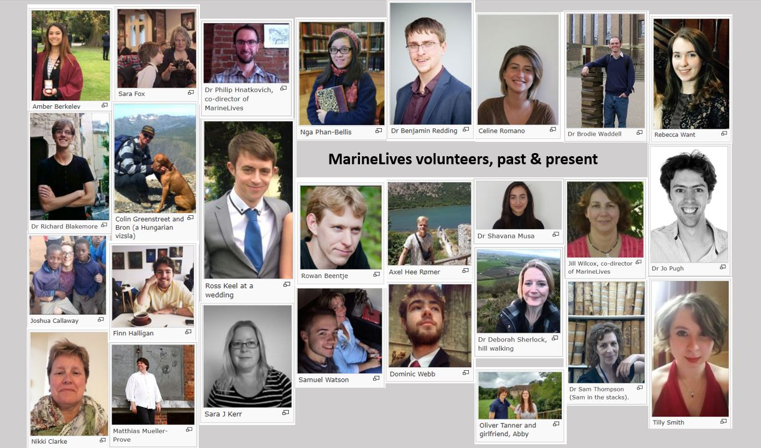
General presentation
@Marinelivesorg @NgaPhB
http://www.marinelives.org/

Slide 3
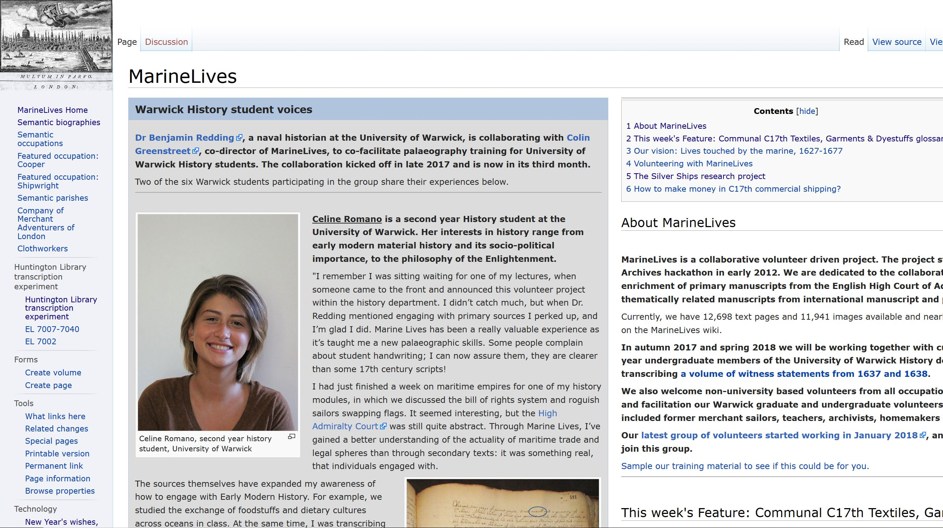
MarineLives
English High Court of Admiralty (HCA)’s manuscripts (1627-1677)
6 million words
12,000 images
Semantic media wiki, published under a CC BY 3.0 licence
@Marinelivesorg @NgaPhB
http://www.marinelives.org/

Slide 4
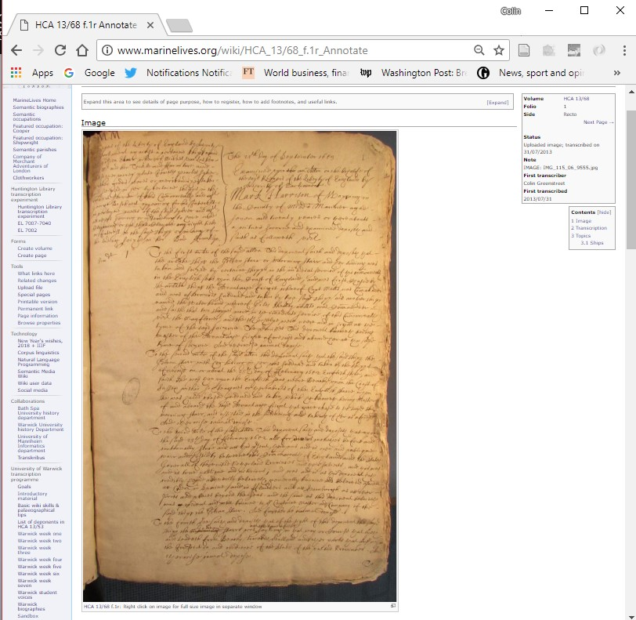
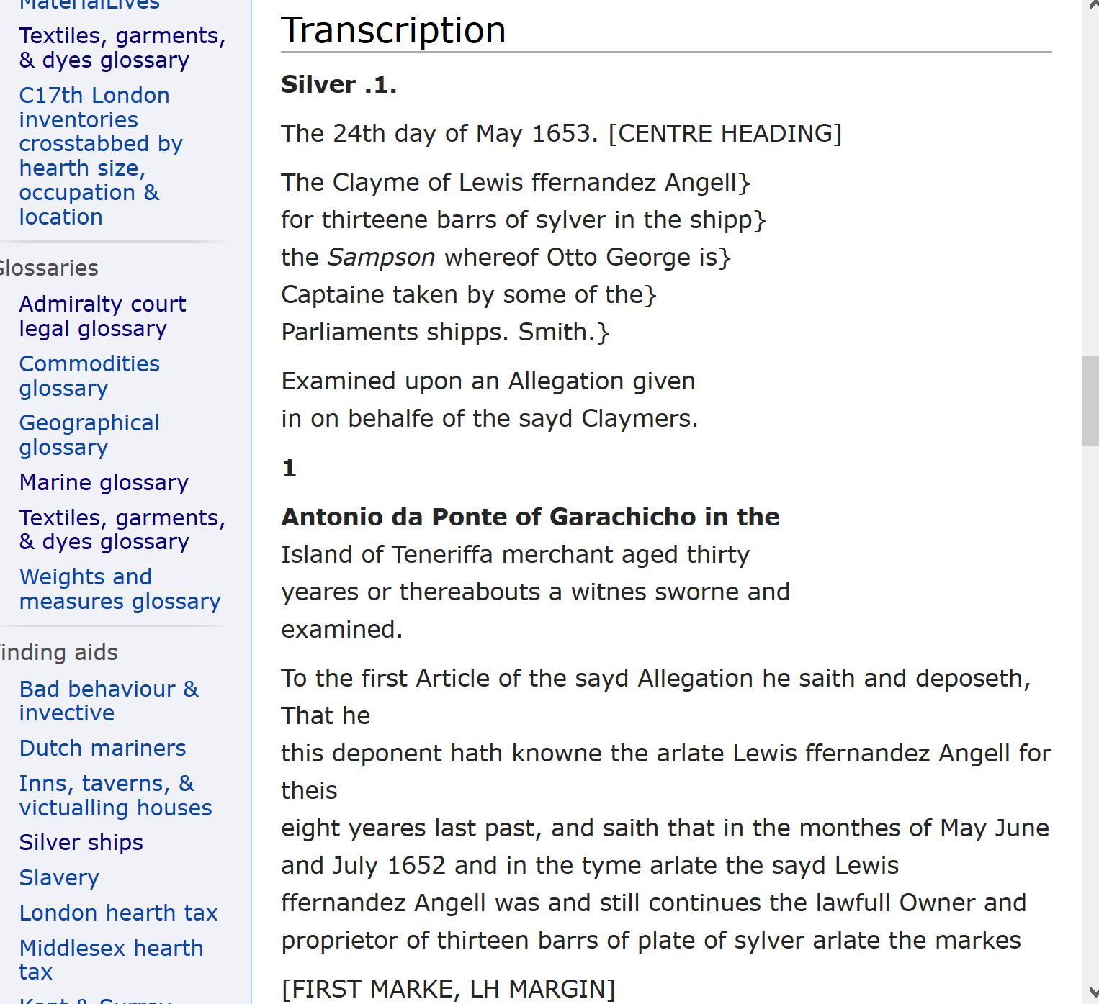
Manuscript’s Digitized image & Transcription
HCA 13/68 f.1r (manuscript)
@Marinelivesorg @NgaPhB
http://www.marinelives.org/

Slide 5
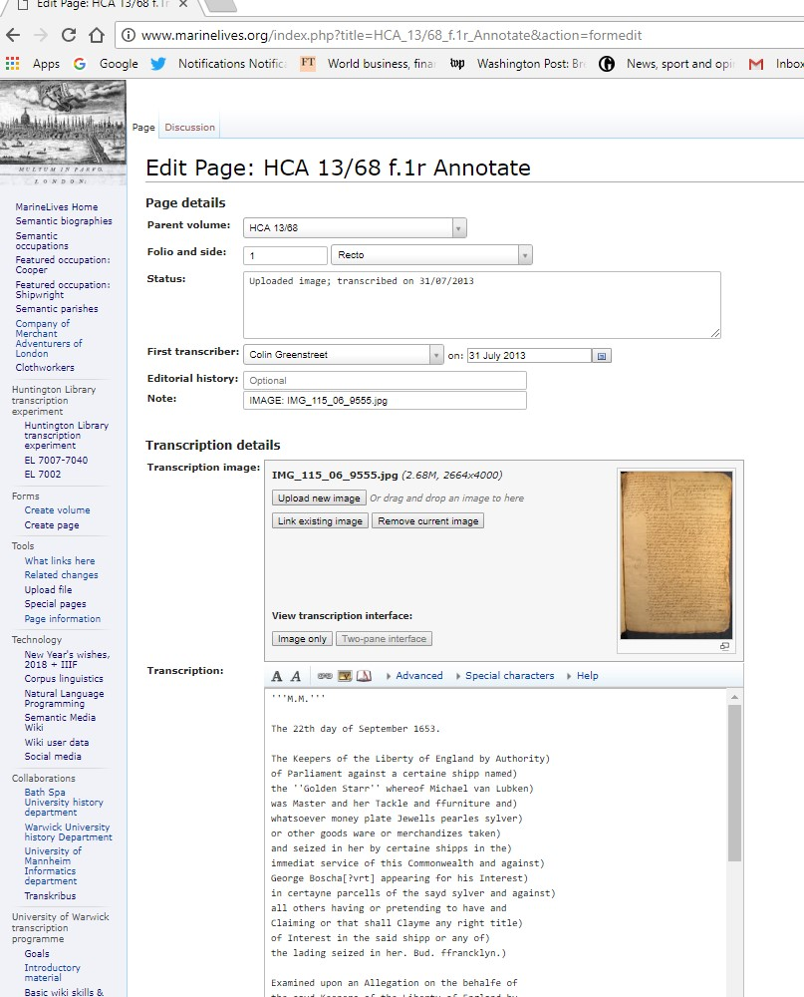
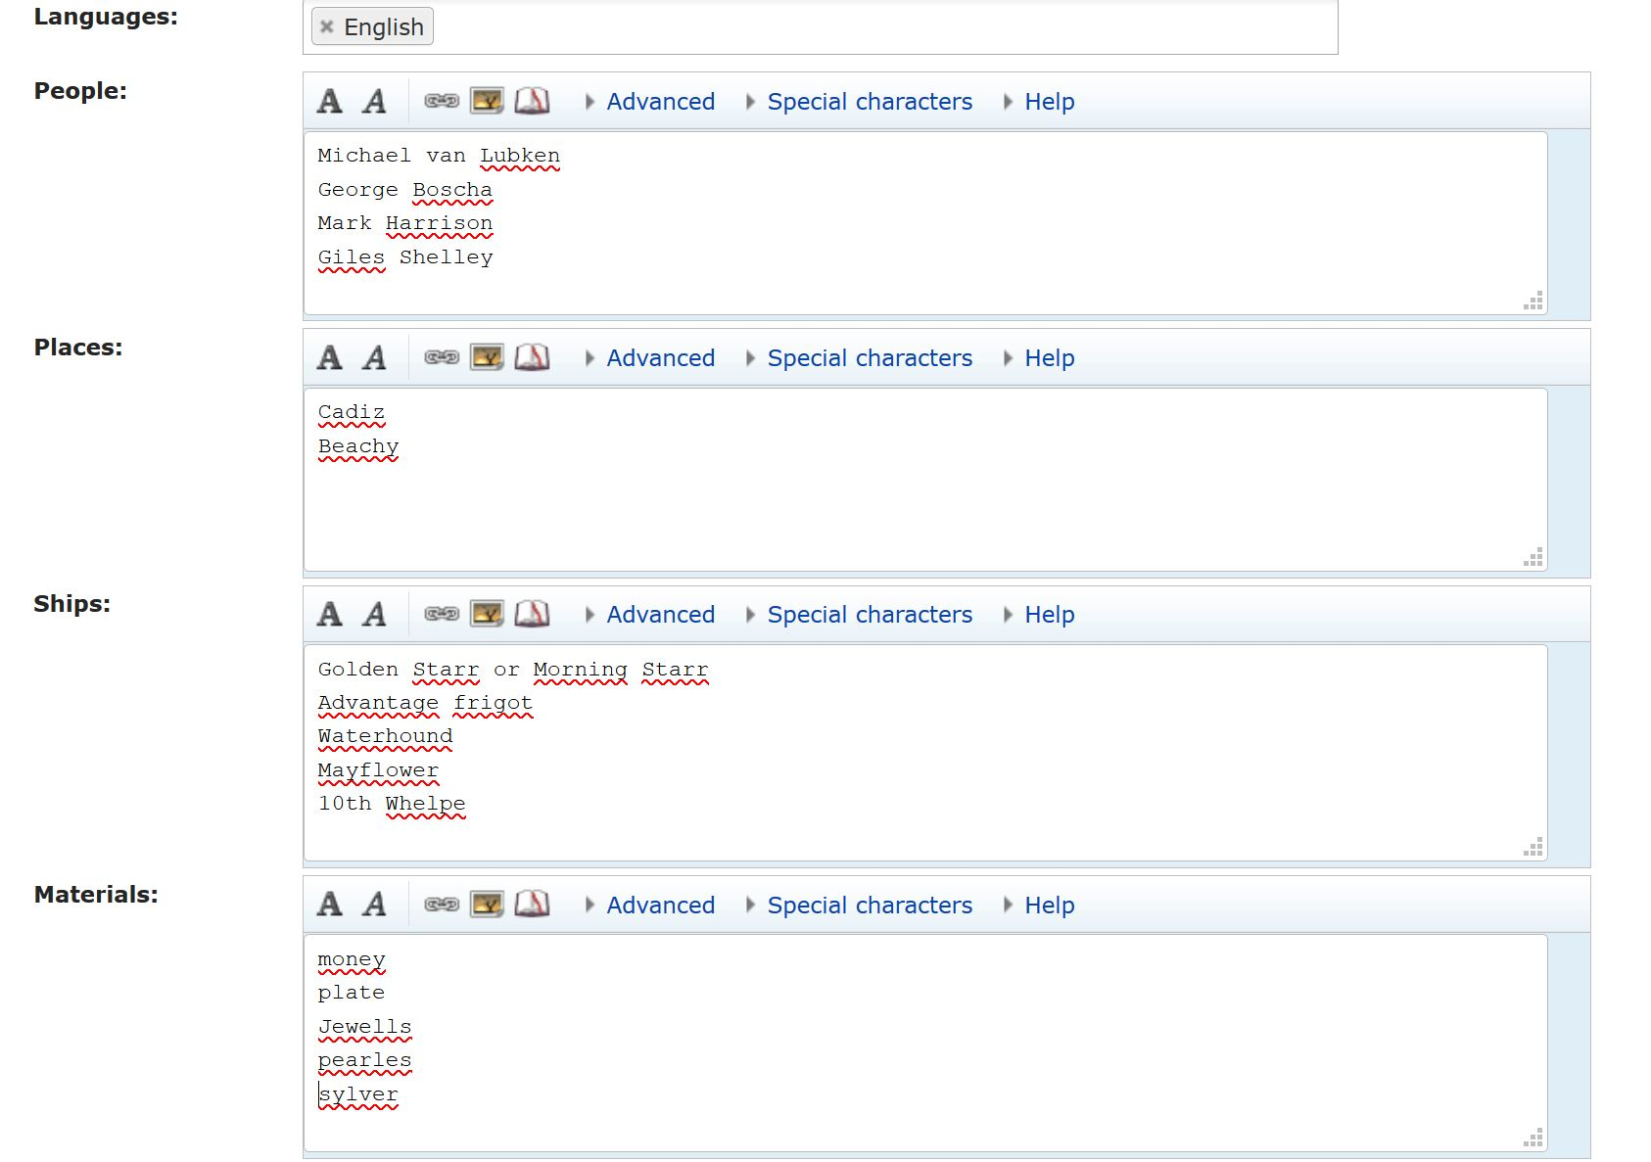
Manuscript’s Edition & Annotation form
HCA 13/68 f.1r (manuscript)
@Marinelivesorg @NgaPhB
http://www.marinelives.org/

Slide 6
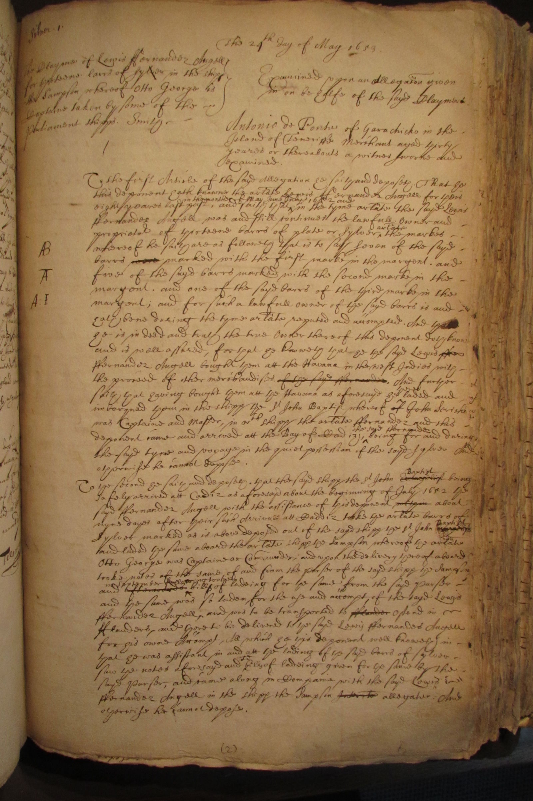
Legal History
@Marinelivesorg @NgaPhB
http://www.marinelives.org/

Slide 7
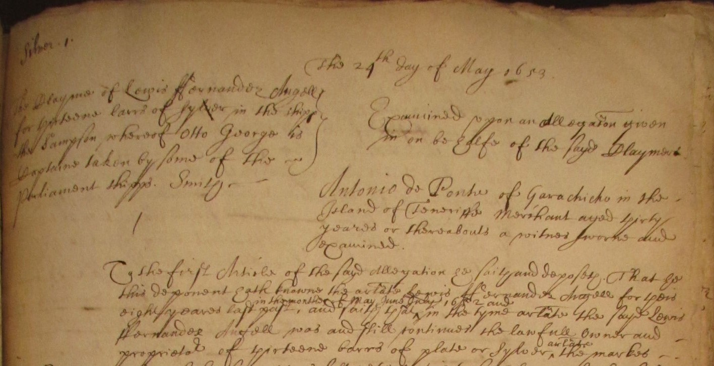
Format of juridical acts
Heading of Depositions or Witness testimonies
Deposition Date
Generic formulation introducing the deponent « Examined upon an allegation given in on behalfe of the sayd claymers »
Name of claimer(s) & description of the claim
Deponent’s details
Name
Address (parish)
Age
Occupation
HCA 13/69 Silver 1 f.1r (manuscript)
@Marinelivesorg @NgaPhB
http://www.marinelives.org/

Slide 8
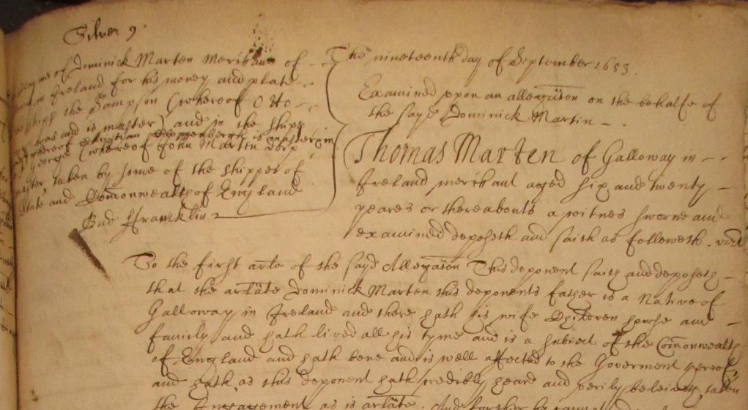
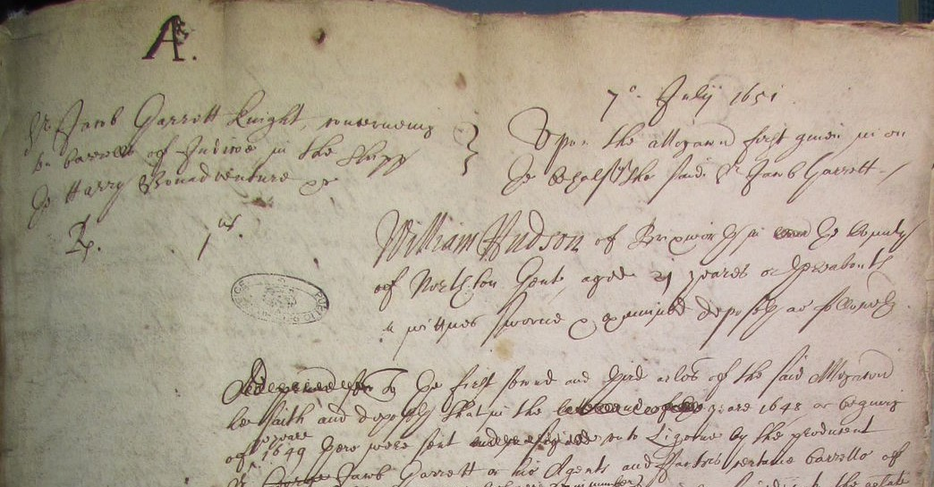
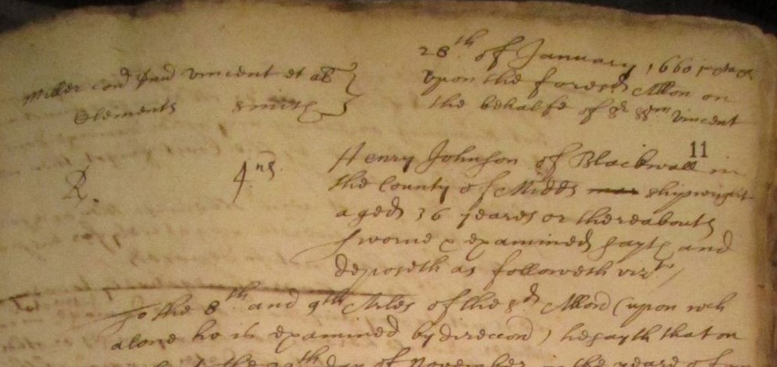
Format of juridical acts
Heading of Depositions or Witness testimonies
HCA 13/65 f.1r (manuscript)
HCA 13/69 Silver 9 f.1r (manuscript)
HCA 13/74 f.11r (manuscript)
@Marinelivesorg @NgaPhB
http://www.marinelives.org/

Slide 9
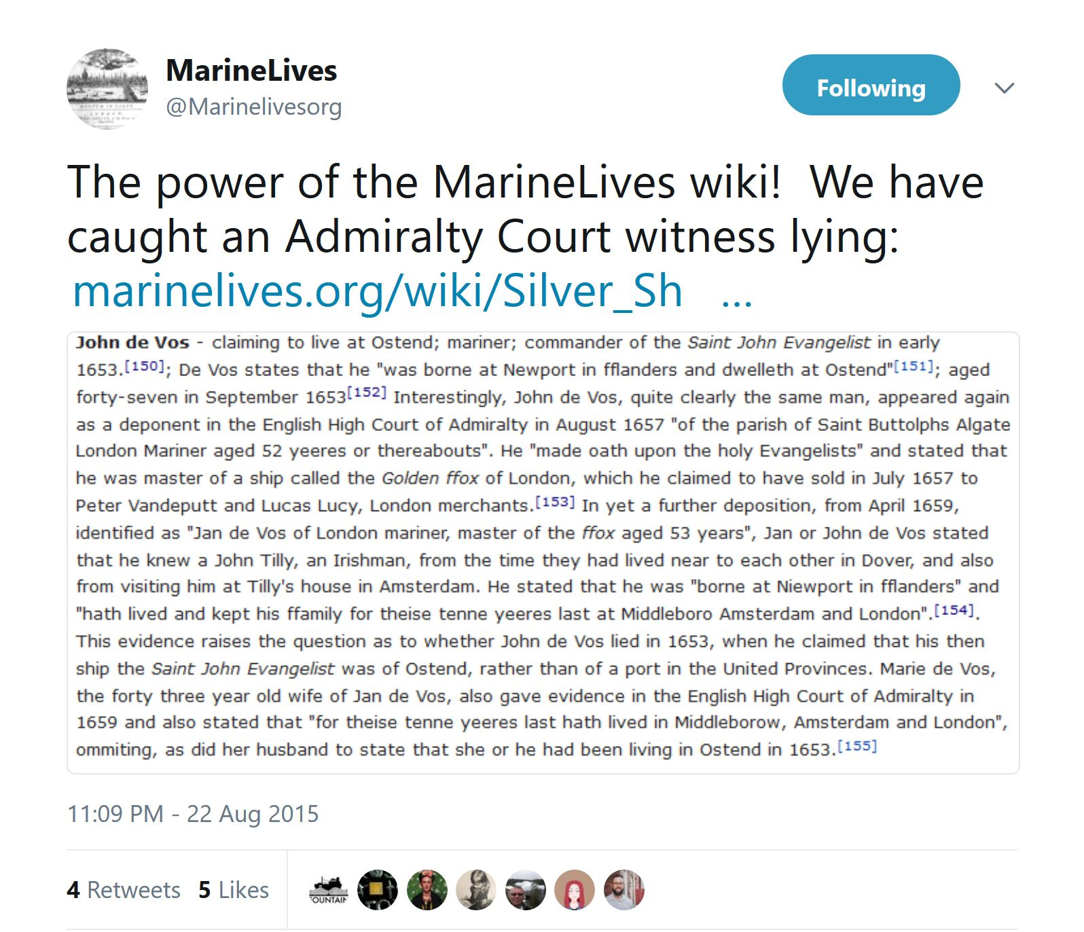
Detecting alterations, omissions and lies
Information deliberately distorted by the same person in different depositions
John de Vos / Jan de Vos
Did he lived in Ostend and therefore was the Saint John Evangelist a ship from Ostend ?
HCA 13/69 f.3v
HCA 13/69 f.4v
HCA 13/67 f.209v
HCA 13/67 f.210r
HCA 13/72 f.85r
HCA 13/73 f.201r
HCA 13/73 f.202r
→ The Three Silver Ships case’s List of witnesses
@Marinelivesorg @NgaPhB
http://www.marinelives.org/

Slide 10
Complex case studies
International research network on the ‘Three Silver Ships’ case
We welcome input from scholars and enthusiasts and are committed to the full acknowledgement of all such input in our planned research outputs.
To date we have received help from
Professor Steve Murdoch (source suggestions on civil law in Louvain; and on Hamburg connection)
@_mapnut: Identified Pieter Goos map of Flanders from 1666 showing Ostend and Dunkirk
José A. Pérez Díez @JoseAPerezDiez: Offer to transcribe Spanish language letter from Don Alonso de Cardenas to Council of State
Dr Kathrin Zickermann: Help on German aspects of the case, including primary and secondary sources on Hamburg/Iberian, and Hamburg/English trade and commercial diplomatic relations
Sam Kaislaniemi @samklai: Offer to help on correspondence times Dunkirk to Cadiz
Dr Sara Barker @DrSKBarker: Input on correspondence times Dunkirk to Cadiz
Harry Perton @Gelkinghe: Input on correspondence times Dunkirk to Cadiz
Vincenzo DM @DM_Vincenzo: Suggestions regarding sources for Archduke Leopold Willem and Simanacas archives in Valladodid
Ruth Selman @Historyscape: Identified correspondence of Don Alonso de Cardenas at TNA
@LeuvenU: Suggested University of Leuven archival contact
Collaborative research team
Dr Richard Blakemore (England)
Dr John Davies (Wales)
Sara Fox (Wales)
Colin Greenstreet (England)
Dr Philip Hnatkovich (United States)
Sara Kerr (Ireland)
Dr Shavana Musa (England)
Nga Bellis-Phan (France)
→ Three Silver Ships case’s main page
@Marinelivesorg @NgaPhB
http://www.marinelives.org/

Slide 11
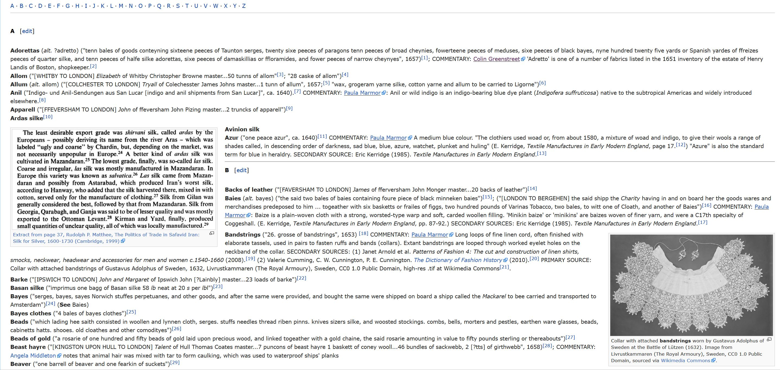
Corpus Linguistics & Historical Linguistics
@Marinelivesorg @NgaPhB
http://www.marinelives.org/

Slide 12
Historical evolution of technical vocabulary
Development of Glossaries
The Textile, Garments and Dyestuffs Glossary
Ca. 1050 terms
34 contributors
600 footnotes linked to sources
→ Link to glossary
@Marinelivesorg @NgaPhB
http://www.marinelives.org/

Slide 13
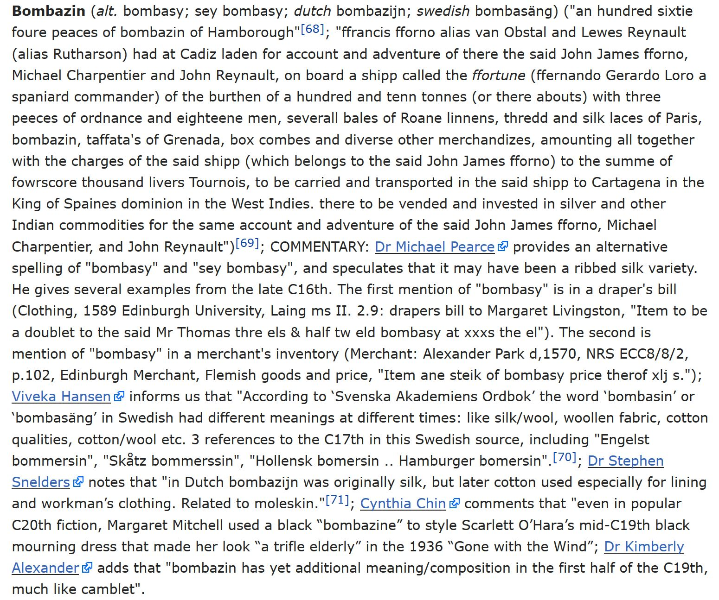
Historical evolution of technical vocabulary
Development of Glossaries
Collection of extracts from the original 17th c. texts of HCA manuscripts using a specific term
Entry enriched with inputs from the community after a Twitter call for help
@Marinelivesorg @NgaPhB
http://www.marinelives.org/

Slide 14
Natural Language Processing (NLP)
With Named Entity Recognition (NER) technique
2014 Collaboration between MarineLives and the University of Mannheim Informatics Department (led by Pr Kai Eckert)
Output: Ritze, Zirn, Greenstreet, Eckert, Ponzetto, ‘Named Entities in Court: The MarineLives Corpus’, in: 9th LREC Proceedings, 2014.
Recognizing persons, locations, and ships’ name.
Technical difficulties with ships’ name: to be dealt with a « pattern-based approach including a learning component »?
@Marinelivesorg @NgaPhB
http://www.marinelives.org/

Slide 15
Methodology for corpus edition
Dr Sam Kaislaniemi (University of Helsinki)
Ensuring cross-platform and cross-disciplinary studies on the same text corpus
Creating downloadable XML files from the digitised texts, in addition to the online user interface
Data formatting to conform to criteria of different disciplines
@Marinelivesorg @NgaPhB
http://www.marinelives.org/

Slide 16
Our vision
@Marinelivesorg @NgaPhB
http://www.marinelives.org/

Slide 17
Our vision for 2018-2023
Grow full text corpus from 6 million to 25 million words
Grow immage collection from 12,000 to 50,000 images
Establishing new archival, library and technology partners (in the United States, United Kingdom, Netherlands)
@Marinelivesorg @NgaPhB
http://www.marinelives.org/

Slide 18
Chronoscopic
http://chronoscopic.org/
We are registering a charitable incorporated organisation under the name of Chronoscopic Education, to be the legal, funding and technology home for MarineLives, our sister project Maphackathon, and our new community, Signs of Literacy.
The aims of Chronoscopic Education are threefold:
(1) To further the teaching of palaeographic, digital research and project management skills, at universities and schools.
(2) To apply insights from small teams in management consultancy and R&D project management, together with tools from data science, to the subject matter of history.
(3) To build a virtual manuscript-based archive and associated research community, which will foster a culture of collaborative scholarship.
@Marinelivesorg @NgaPhB
http://www.marinelives.org/

Slide 19
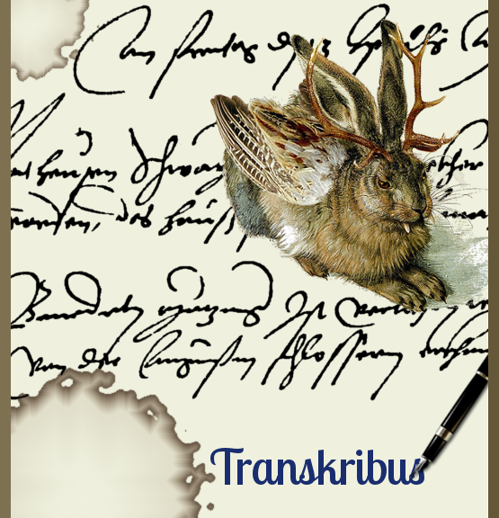
Transkribus
Planned collaboration with Transkribus
Using pattern recognising key word spotting technology
Providing researchers with manuscripts relevant to their key word searches
Applied to untranscribed Admiralty Court manuscripts
@Marinelivesorg @NgaPhB
http://www.marinelives.org/

Slide 20
IIIF Conference Washington
@Marinelivesorg @NgaPhB
http://www.marinelives.org/

